Slide 1



Tutorial Kotlin
muhamad.soleh@iti.ac.id
Sumber: https://www.w3schools.com/KOTLIN/index.php

Slide 2
Kotlin Tutorial
Kotlin Intro
Kotlin Get Started
Kotlin Syntax
Kotlin Output
Kotlin Comments
Kotlin Variables
Kotlin Data Types
Kotlin Operators
Kotlin Strings
Kotlin Booleans
Kotlin If...Else
Kotlin When
Kotlin While Loop
Kotlin Break/Continue
Kotlin Arrays
Kotlin For Loop
Kotlin Ranges
Kotlin Functions

Slide 3
What is Kotlin?
Kotlin is a modern, trending programming language that was released in 2016 by JetBrains.
It has become very popular since it is compatible with Java (one of the most popular programming languages out there), which means that Java code (and libraries) can be used in Kotlin programs.
Kotlin is used for:
Mobile applications (specially Android apps)
Web development
Server side applications
Data science
And much, much more!
Why Use Kotlin?
Kotlin is fully compatible with Java
Kotlin works on different platforms (Windows, Mac, Linux, Raspberry Pi, etc.)
Kotlin is concise and safe
Kotlin is easy to learn, especially if you already know Java
Kotlin is free to use
Big community/support

Slide 4
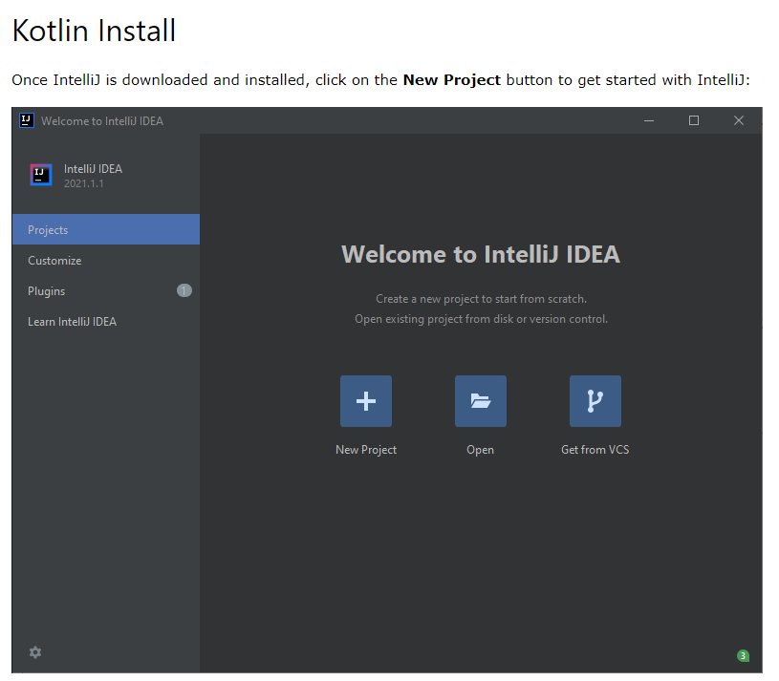
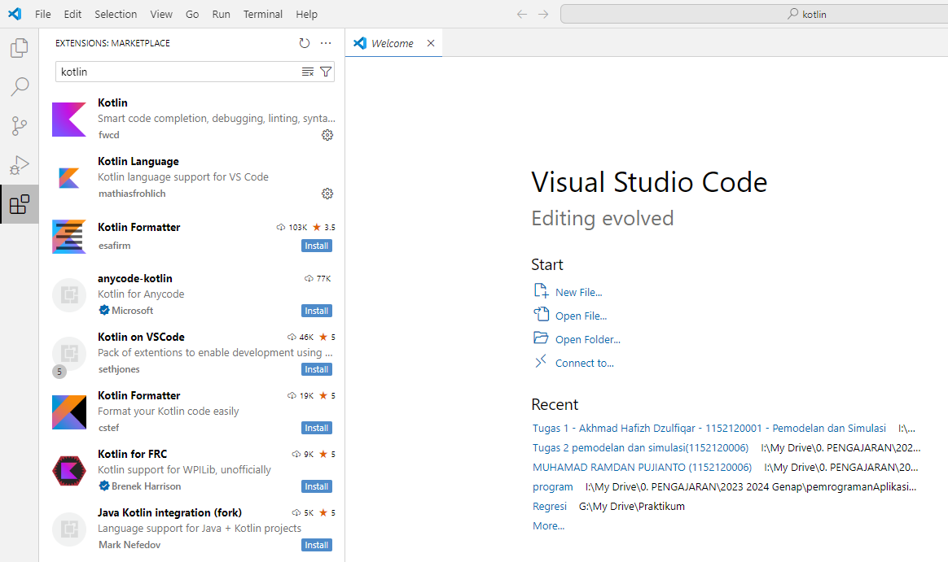
Kotlin Get Started

Slide 5

Kotlin Syntax
we created a Kotlin file called Main.kt, and we used the following code to print "Hello World" to the screen:
The fun keyword is used to declare a function. A function is a block of code designed to perform a particular task. In the example above, it declares the main() function.
The main() function is something you will see in every Kotlin program. This function is used to execute code. Any code inside the main() function's curly brackets {} will be executed.
For example, the println() function is inside the main() function, meaning that this will be executed. The println() function is used to output/print text, and in our example it will output "Hello World".

Slide 6
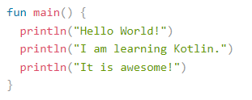
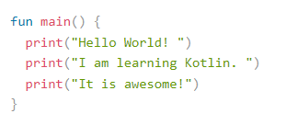
Kotlin Output
The println() function is used to output values/print text:
There is also a print() function, which is similar to println(). The only difference is that it does not insert a new line at the end of the output:

Slide 7


Kotlin Comments
Single-line Comments
Single-line comments starts with two forward slashes (//).
Any text between // and the end of the line is ignored by Kotlin (will not be executed).
Multi-line Comments
Multi-line comments start with /* and ends with */.
Any text between /* and */ will be ignored by Kotlin.

Slide 8
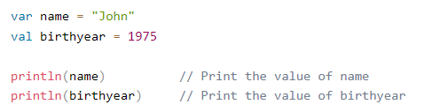
Kotlin Variables
Kotlin Variables
Variables are containers for storing data values.
To create a variable, use var or val, and assign a value to it with the equal sign (=):
The difference between var and val is that variables declared with the var keyword can be changed/modified, while val variables cannot.

Slide 9
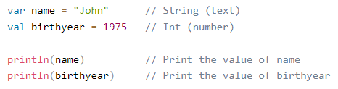
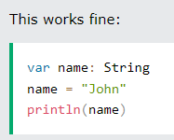
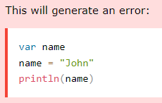
Variable Type
Unlike many other programming languages, variables in Kotlin do not need to be declared with a specified type (like "String" for text or "Int" for numbers, if you are familiar with those).
You can also declare a variable without assigning the value, and assign the value later. However, this is only possible when you specify the type:

Slide 10


Display Variables
Like you have seen with the examples above, the println() method is often used to display variables.
To combine both text and a variable, use the + characte
When you create a variable with the val keyword, the value cannot be changed/reassigned.
So When To Use val?
The val keyword is useful when you want a variable to always store the same value, like PI (3.14159...)

Slide 11
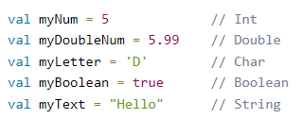
Kotlin Data Types
In Kotlin, the type of a variable is decided by its value
Data types are divided into different groups:
Numbers
Characters
Booleans
Strings
Arrays

Slide 12
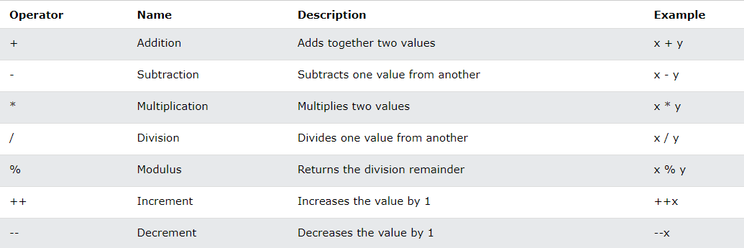
Kotlin Operators

Slide 13
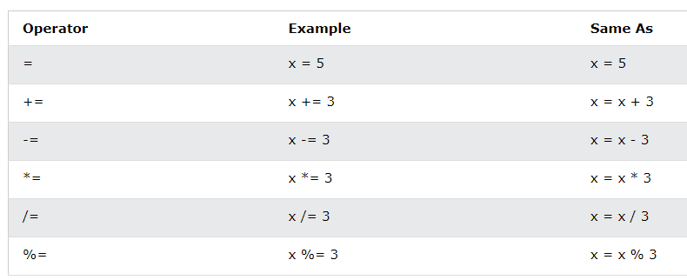
Kotlin Operators

Slide 14
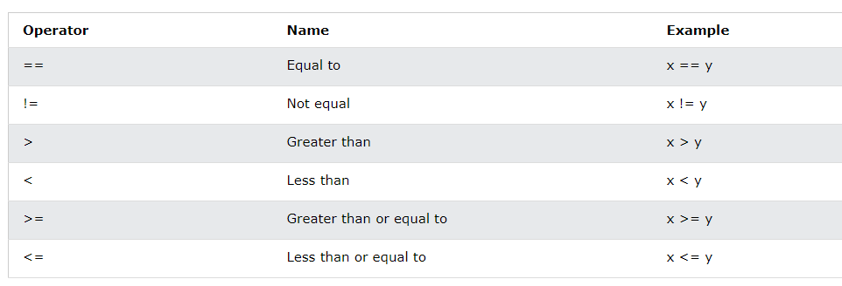
Kotlin Operators

Slide 15
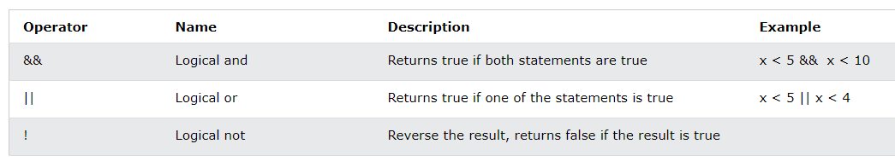
Kotlin Operators

Slide 16
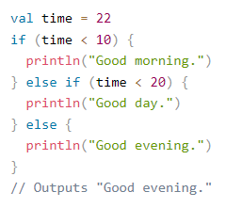
Kotlin If ... Else
Kotlin supports the usual logical conditions from mathematics:
Less than: a < b
Less than or equal to: a <= b
Greater than: a > b
Greater than or equal to: a >= b
Equal to a == b
Not Equal to: a != b
You can use these conditions to perform different actions for different decisions.
Kotlin has the following conditionals:
Use if to specify a block of code to be executed, if a specified condition is true
Use else to specify a block of code to be executed, if the same condition is false
Use else if to specify a new condition to test, if the first condition is false
Use when to specify many alternative blocks of code to be executed

Slide 17
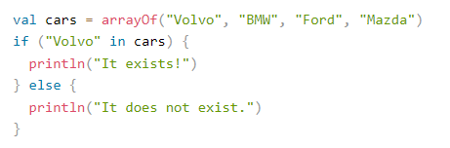

Kotlin Arrays
Arrays are used to store multiple values in a single variable, instead of creating separate variables for each value.

Slide 18
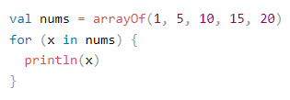
Kotlin For Loop
Often when you work with arrays, you need to loop through all of the elements.

Slide 19
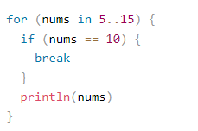
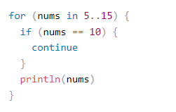
Kotlin Ranges
With the for loop, you can also create ranges of values with "..":

Slide 20
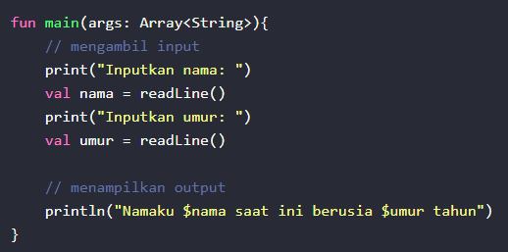
Kotlin Functions
A function is a block of code which only runs when it is called.
You can pass data, known as parameters, into a function.
Functions are used to perform certain actions, and they are also known as methods.
"There are three ways to take input from the keyboard:
Using the readLine() function
Using the Scanner class
Using the BufferedReader class"

